Slide 1
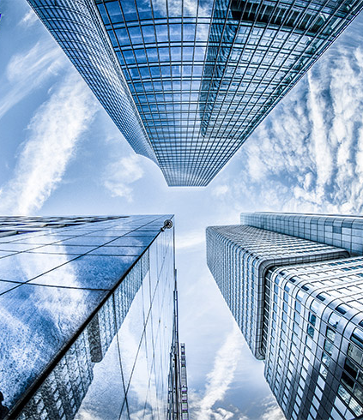
Assignment 3
IR
Information Retrieval
2021-CS-39 (Mustafa Riaz)

Slide 2
Scope of the project
Implement document retrieval system to retrieve documents with:
Probabilistic Model
Non-Overlapped List
Proximal Nodes

Slide 3
What is Indexer?
What is an Indexer?
An indexer is a system or process that creates an organized catalog or reference, making it easier to locate specific information in a large dataset or collection.

Slide 4

Layman Example
Imagine you have a huge photo album with thousands of pictures from different events over the years.
Arrange and reference the images by Year.

Slide 5

Computer Example
On a computer, a search engine is an excellent example of an indexer. When you search for a keyword like "beach vacation" on your computer, the search engine doesn’t look through each document one by one. Instead, it relies on an index that maps words or phrases to files and folders. This index was created when the computer scanned files and recorded keywords associated with each one. Now, searching is much faster because the indexer points directly to relevant files.

Slide 6
Working of the Indexer:
Load and Process Documents
Preprocess content
Indexing
Show Results on query

Slide 7
Working of the Indexer:
1. Load Documents
1. Simple checks the directory for all the documents having .txt extensions and loads them
2.Devides the loaded document in two parts, with their content and title

Slide 8
Working of the Indexer:
2. Preprocess Content
Removing Empty Spaces
Checking and Removing Verbs and non-nouns
Filtering nouns

Slide 9
Working of the Indexer:
2. Preprocess Content
Removing Empty Spaces
Remove the leading and trailing spaces
Reduce multiple spaces to single space
Example:
" Running quickly, the brown fox jumps over lazy dogs. “
" Running quickly, the brown fox jumps over lazy dogs. "

Slide 10
Working of the Indexer:
2. Preprocess Content
Removing Verbs
Using a list of non-nouns
Example:
non_nouns = {"the", "a", "an", "on", "over", "while“}
Using Condition words ending with ( ing, ed, ly).
Example:
Running, Played, Quickly.

Slide 11
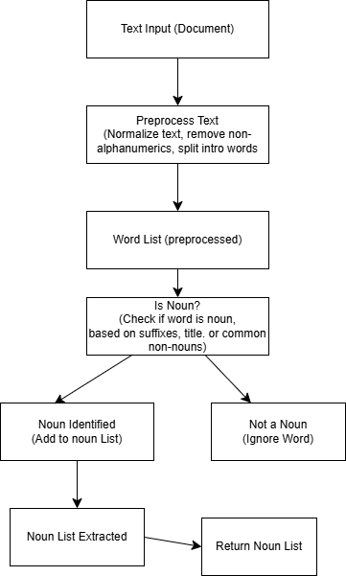
DFD of Text Preprocessing

Slide 12
Working of the Indexer:
2. Preprocess Content
Filtering nouns
Using common noun suffix
Example:
common_noun_suffixes = ('ness', 'ity', 'tion‘)
Happiness, Ability, Celebration etc.

Slide 13
Working of the Indexer:
3. Indexing
The values are stored in key pair
Using a custom Linked_List_Dictionary as an index
Index has further multiple nodes
Nodes has further sub elements to store key, value and next (to reference next node)

Slide 14
Working of the Indexer:
3. Indexing
Key stores the title of the document
Value stores the noun filtered from the document Content

Slide 15
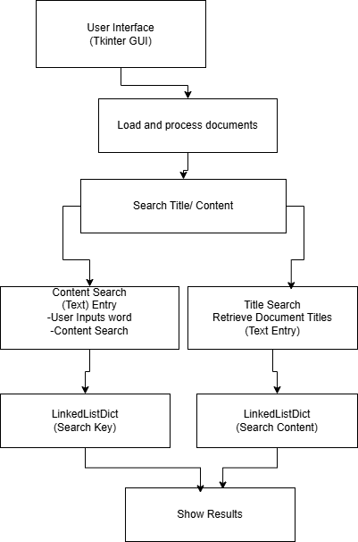
DFD of Complete Program

Slide 16
Thank You.
IR
Information Retireval

